Slide 1
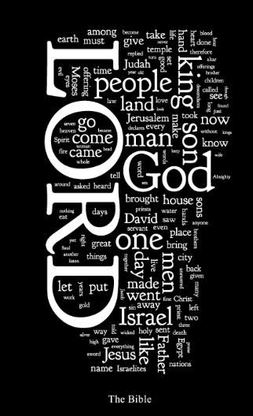


Slide 2
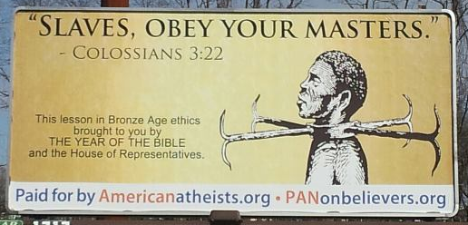
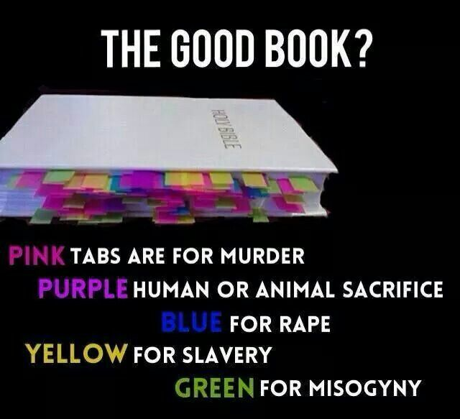
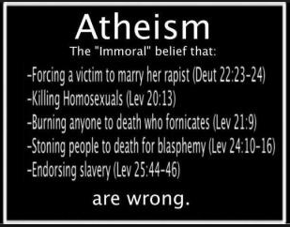

Slide 3

18-29- only 12% said that it was the actual Word of God and over 50% said that not everything in it had to be followed.
30-49- only 24% said that it was the literal word of God and to be followed.
50-64- only 31% said it was the literal word of God.
65+- sadly only 27% said that the Bible should be followed and that it is God’s Word.

Slide 4



Slide 5
The Bible Claims
“Every writing is God-breathed, and profitable for teaching, for conviction, for setting aright, for instruction that is in righteousness, that the man of God may be fitted-for every good work having been completed.” IITim.3:16-17 YLT

Slide 6
The Bible Claims
“Knowing this first, that no prophecy of scripture is of any private interpretation, for prophecy never came by the will of man, but holy men of God spoke as they were moved by the Holy Spirit.”
II Peter 1:20-21 NKJV

Slide 7
How Do We Know:
What we have today is what was originally penned?
That there aren’t significant errors?
There hasn’t been some secret collusion to modify our text?

Slide 8
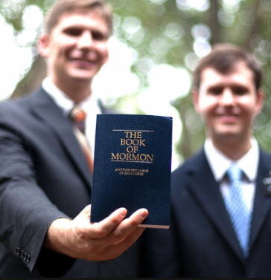
“Mormons believe that the Book of Mormon, unlike the Bible, was translated correctly and is the unaltered word of God.” –The Holy Books of the Church of Christ of Latter Day Saints BBC News Article

Slide 9
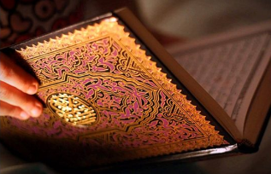
“Muslims understand the Quran’s versions to be witness accounts from an omnipotent God. As such, Muslims generally hold that the earlier versions are distorted through flawed processes of transmission and interpretation, and understand the Quran’s versions to be more accurate to the actual events.” -Wikipedia

Slide 10
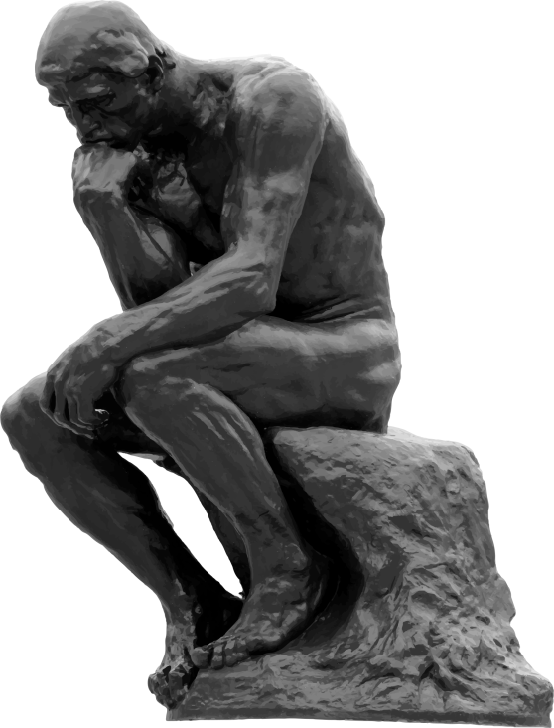
The earlier book shows the later books to be wrong, when the earlier one is written by 40 different men, over 1500 years, was witnessed by many and is still consistent.
Where are all the witnesses for the Quran or the Book of Mormon?
What’s Thinking Man Thinking About?

Slide 11
Verifying Ancient Texts
How Many Copies Exist?
The more copies, the more comparisons we can make to find ‘slips of the pen’ by those making the copies.

Slide 12
Other Ancient Documents
The Annals of Tacitus, a Roman historian – 2 copies
The writings of Plato – only 7
The writings of Herodotus – only 8
The Writings of Thucydides- 8 copies plus a few fragments
Caesar’s Gallic Wars – 10 copies in total
Roman Historian Livy- wrote 142 books of which only 35 survived and we have 20 copies of those.
Popular classical authors are better represented. We have hundreds of copies of Euripides, Cicero, Ovid, and Virgil

Slide 13
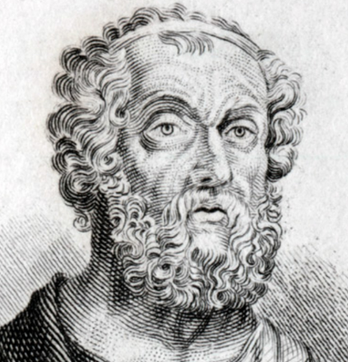
Homer’s Iliad-1,758 Copies

Slide 14
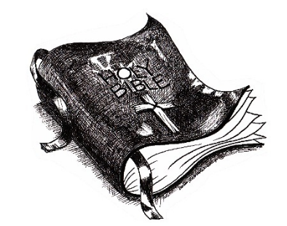
The New Testament
5,800 complete or mostly complete manuscripts
13,000 Fragments
10,000 Latin translations of the Greek text
8,000 manuscripts in Syriac, Armenian, Ethiopic, Coptic, Gothic, Slavic, Sahidic and Georgian

Slide 15
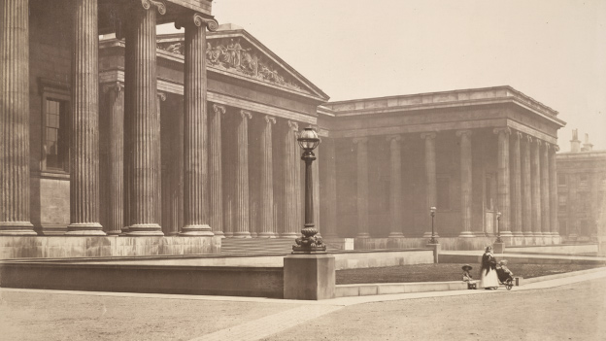
British Museum
“89,000 quotes or allusions to the New Testament in the writings of early Christian writers.”

Slide 16
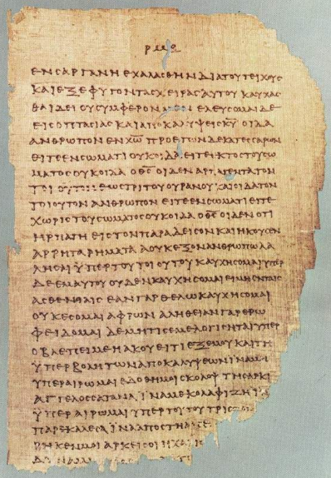
1,800
6th Century
Lectionaries

Slide 17
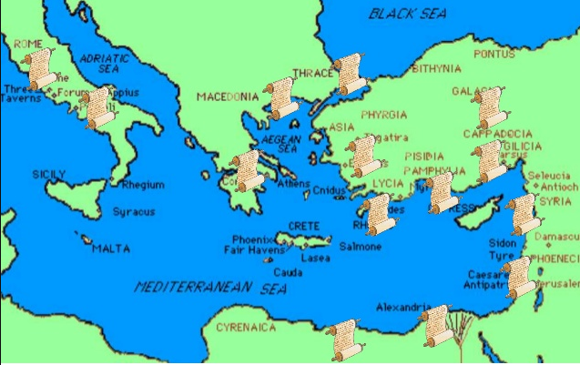
New Testament Texts Were Found:
Egypt
Ethiopia
Palestine
Syria
Turkey
Greece
Italy

Slide 18

How Much Time Elapsed Between Original & Surviving Copies?

Slide 19
Other Ancient Documents
Histories of Herodotus- Earliest copy 1,350 years after original
Histories of Thucydides- Earliest copy 1,300 years after original
Caesar's Gallic Wars- 950 years after original
Annals of Tacitus- 950 years after original
Histories of Tacitus- 750 years after original
The Iliad- 350-400 years after original
Roman History of Livy- 350 years after the original and the copy is a fragment!

Slide 20
The New Testament
Several Fragments dated to 40 to 100 years after original writings
John Ryland fragment 100-150 AD (a gap of about 50 years)
The Boder Papyri 200 AD (a gap of about 100-140 years)
Chester Beatty Papyri 250 AD (a gap of 150-200 years)

Slide 21
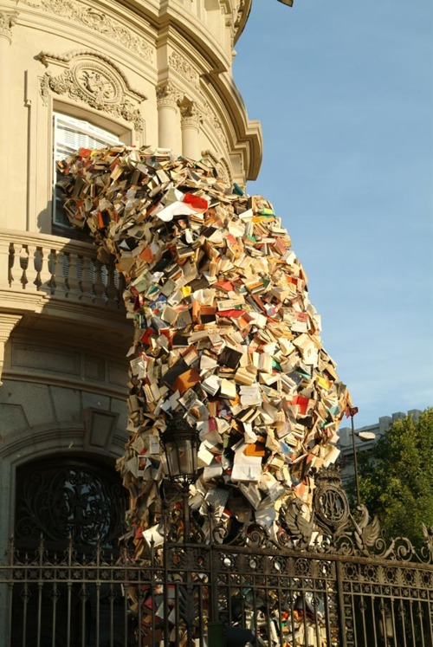
The Evidence Keeps Mounting!!!

Slide 22
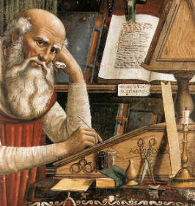
Variations
  How different are the various copies?
The More Errors The Less Certain We Can Be About The Original

Slide 23
New Testament
28,000+
Manuscripts, Fragments, etc.
Less Than ½ a Percent
Homer’s Iliad
1,569 Copies
5% Variation

Slide 24
“It would be a mistake, however, to assume that the only changes being made were by copyists with a personal stake in the wording of the text. In fact, most of the changes found in our early Christian manuscripts have nothing to do with theology or ideology. Far and way the most changes are results of mistakes, pure and simple – slips of the pen, accidental omissions, in advertent additions, misspelled words, blunders of one sort or another” [Bart Ehrman, Misquoting Jesus, p. 55]

Slide 25
“Variant reading should not be counted by adding all the various readings in all the manuscripts. For example, a word spelled differently from the standard text in 500 manuscripts is not counted as 500 variants. It is counted as one variant” [Norman Geisler, “Updating the Manuscript Evidence for the New Testament,” 2013]

Slide 26
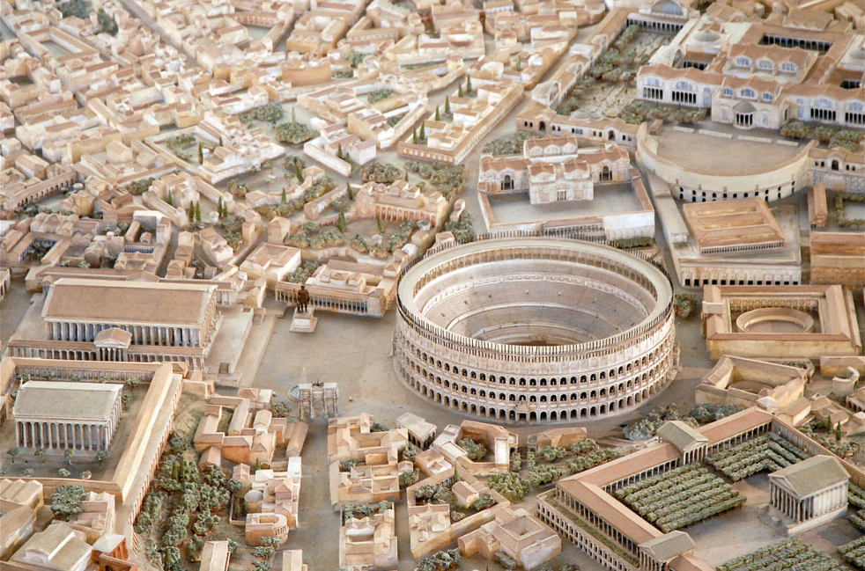
“Now, some of the Jews thought that the destruction of Herod’s army came from God, and that very justly, as a punishment of what he did against John, that was called the Baptist; for Herod slew him, who was a just man and commanded the Jews to exercise virtue, both as to righteousness towards one another, and piety towards God, and so to come to baptism.” Antiquities, 18:5:2

Slide 27
“Now, there was about this time, Jesus, a wise man, if it be lawful to call him a man, for he was a doer of wonderful works, a teacher of such men as receive the truth with pleasure. He drew over to him both many of the Jews, and many of the Gentiles. He was the Christ; and when Pilate, at the suggestion of the principle men amongst us, had condemned him to the cross, those that loved him at the first did not forsake him, for he appeared to them alive again the third day, as the divine prophets had foretold and ten thousand other wonderful things concerning him; and the tribe of Christians, so named from him, are not extinct at this day.” Antiquities, 18:3:3

Slide 29


